Slide 1

HEART DISEASE
PREDICTION
USING LOGISTIC REGRESSION
PRESENTED BY :- SUBHAM ROY

Slide 2



INTRODUCTION
THIS PROJECT IS RELATED TO HEART DISEASE PREDICTION.
Heart disease has been the leading cause of death worldwide for the past 10 years.
There are several different symptoms associated with heart disease, which makes it difficult to diagnose quickly and accurately.
Machine learning techniques can help solve this problem by analyzing medical data and predicting the chances of heart disease more efficiently..

Slide 3

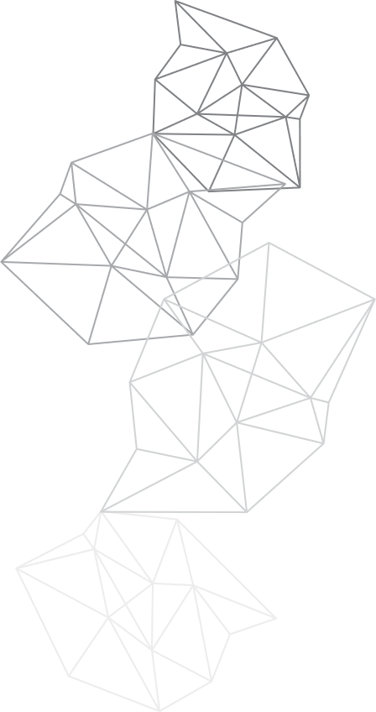

PROBLEM STATEMENT
Heart disease is difficult to diagnose early because symptoms vary and traditional diagnostic tools are costly or less efficient.
There is a need for a fast, accurate, and affordable machine learning model that can predict heart disease using patient medical data.
Lack of early prediction increases the risk of severe complications, making timely detection essential for reducing mortality rates.

Slide 4

PROJECT OVERVIEW
THIS PROJECT FOCUSES ON PREDICTING HEART DISEASE USING MACHINE LEARNING TECHNIQUES, SPECIFICALLY LOGISTIC REGRESSION.
The system analyzes key medical attributes such as age, blood pressure, cholesterol, heart rate, and other clinical features to determine the risk of heart disease.
The goal of the project is to provide a fast, reliable, and cost-effective tool that helps in early diagnosis and improves patient health outcomes.

Slide 5






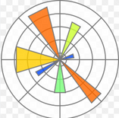
REQUIRED PACKAGES AND LIBRARIES
PANDAS
PYTHON
Used for loading the dataset, cleaning data, and handling tables.
Python is used because it is simple and has powerful libraries for machine learning and data analysis
NUMPY
SEABORN
Used for numerical operations and array handling.
For advanced visualizations like heatmaps and pairplots
SCIKIT-LEARN
MATPLOTLIB
LogisticRegression (Machine Learning model)
train_test_split (splitting data)
StandardScaler (data scaling)
metrics (accuracy, confusion matrix, classification report)
Used for creating visualizations such as graphs and charts.

Slide 6




PROCESS
COLLECT THE DATA
IMPORTING
LIBRARIES
EDA ON DATASET
PANDAS
LOGISTIC REGRESSION
TRAIN – TEST SPLIT
K NEAREST NEIGHBOUR
NUMPY
SUPPORT VECTOR CLASSIFIER
SKLEARN
DECISION TREE CLASSIFIER
MATPLOTLIB
RANDOM FOREST CLASSIFIER
APLLY DIFFERENT CLASSIFICATION MODELS
SEABORN
FINAL MODEL
IMPLEMENTATION
PREDICTION
ACCURACY

Slide 7

EDA
DATASET SHAPE :- CHECKED TOTAL ROWS & COLUMNS USING
DF.SHAPE .
DATASET INFORMATION:- VIEWED COLUMN NAMES, DATA TYPES,
AND MEMORY USAGE USING DF.INFO().
STATISTICAL SUMMARY:- USED DF.DESCRIBE() TO UNDERSTAND
MEAN, MIN, MAX, AND DISTRIBUTION OF
ALL NUMERICAL FEATURES.
CROSSTAB ANALYSIS:- COMPARED SEX VS TARGET USING
PD.CROSSTAB(DF['TARGET'], DF['SEX']).
MISSING VALUE CHECK:- ENSURED DATA QUALITY USING
DF.ISNULL().SUM() (NO MISSING VALUES
FOUND).
CORRELATION MATRIX:- CALCULATED CORRELATION BETWEEN
FEATURES USING DF.CORR() .
HEATMAP:-VISUALIZED CORRELATIONS USING SEABORN HEATMAP
TO IDENTIFY STRONG AND WEAK RELATIONSHIPS.
HISTOGRAMS:- PLOTTED DISTRIBUTION OF ALL FEATURES WITH
DF.HIST() TO ANALYZE SPREAD AND OUTLIERS.
01.
Data Input:
MACHINE LEARNING

Slide 8
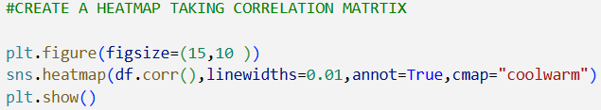
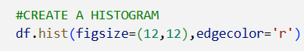
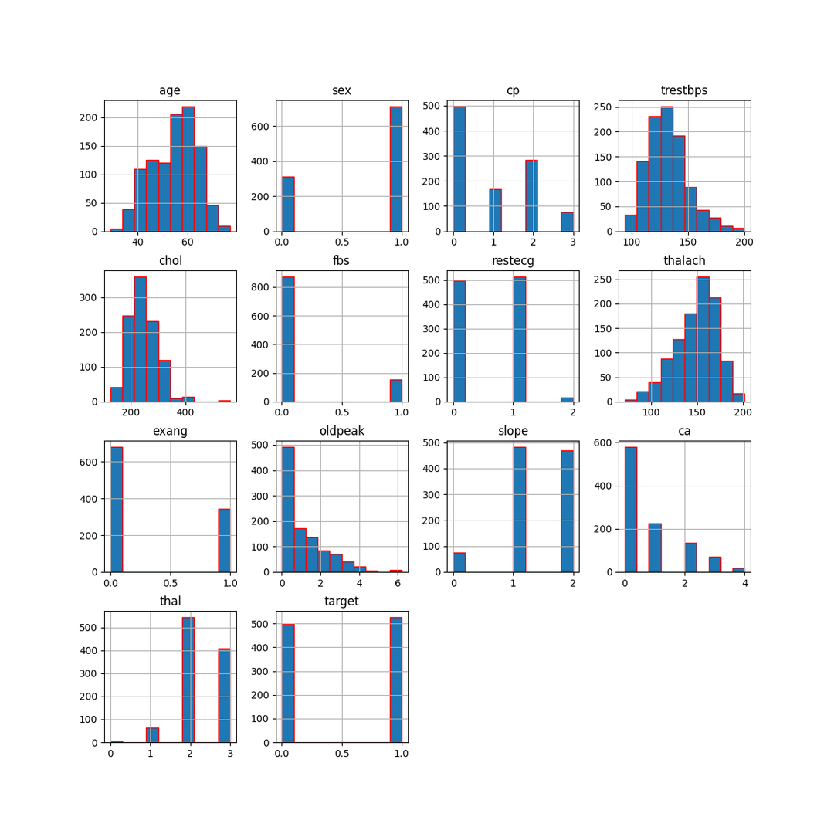
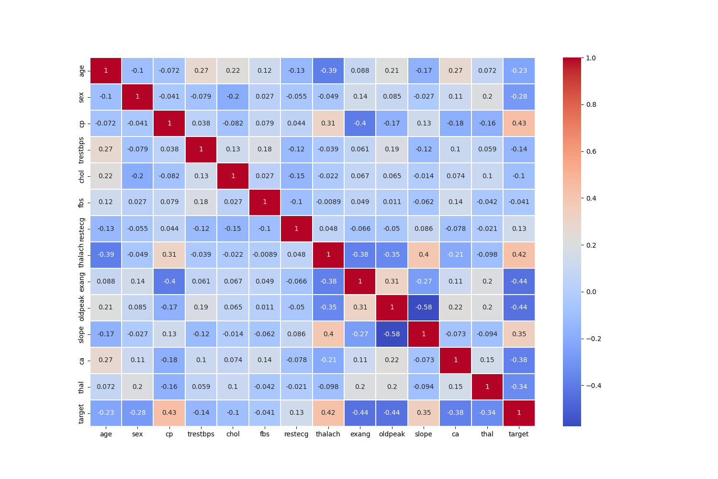
HEATMAP AND HISTOGRAM

Slide 9

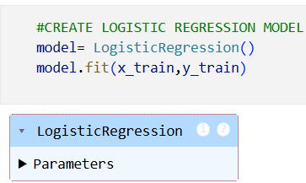
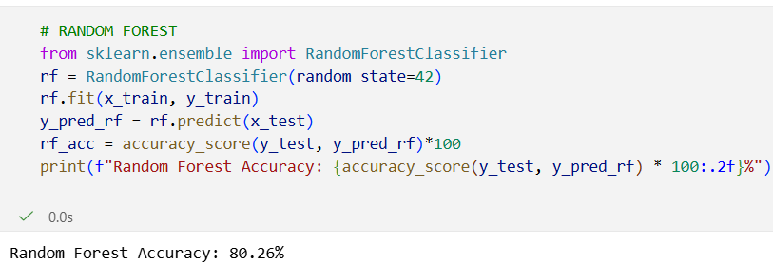
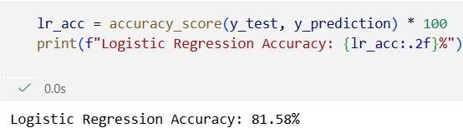
CLASSIFICATION MODELS
1. LOGISTIC REGRESSION
2. RANDOM FOREST
Logistic Regression is a machine learning algorithm used to predict a binary outcome — something that has only two possible results.
In this project, Logistic Regression is used to predict whether a person has heart disease or not based on several medical features such as age, sex, chest pain, cholesterol level, blood pressure, and more.
Since the output has only two classes (0 = No Disease, 1 = Disease), logistic regression is the most suitable model.
Random Forest is a classification algorithm that builds many decision trees and combines their results to make a final prediction.
In this project, it analyzes features like age, cholesterol, blood pressure, thalach, and oldpeak, then uses majority voting from all trees to predict whether a person has heart disease (1) or not (0). It improves accuracy, reduces overfitting, and shows which features are most important.

Slide 10
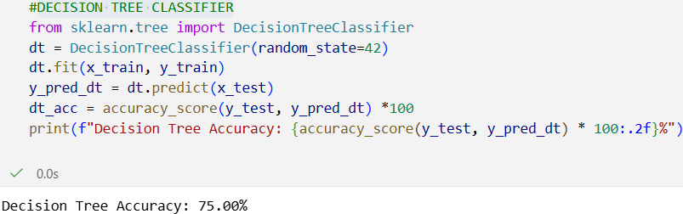
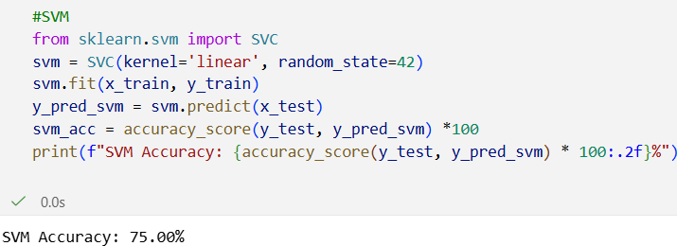
CLASSIFICATION MODELS
3.DECISION TREE CLASSIFIER
4.SUPPORT VECTOR MACHINE (SVM)
A Decision Tree Classifier is a machine learning algorithm that uses a tree-like structure of decisions to classify data into categories.
It splits the dataset based on conditions (like age, cholesterol, chest pain type, etc.) to form branches. Each split makes the data more pure, and the final leaf node gives the prediction: 1 = heart disease or 0 = no heart disease. It works like a simple flowchart that decides the outcome step-by-step.
Support Vector Machine (SVM) is a supervised machine-learning algorithm used for classification and regression that finds the best separating boundary (hyperplane) between different classes.
SVM works by choosing a line (in 2D) or a plane (in higher dimensions) that maximally separates the classes. It focuses only on the most important data points, called support vectors, which lie closest to the boundary. This makes SVM highly accurate and effective, especially for complex and high-dimensional data.

Slide 11
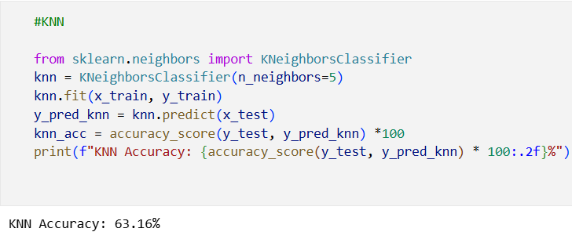
CLASSIFICATION MODELS
5. K-NEAREST NEIGHBORS (KNN)
K-Nearest Neighbors (KNN) is a simple supervised machine-learning algorithm used for classification and regression that makes predictions based on the k closest data points in the dataset.
KNN does not build any model. Instead, when a new data point comes, it looks at its nearest neighbors (based on distance like Euclidean distance) and predicts the class that is most common among them. The choice of k (number of neighbors) plays an important role in accuracy.

Slide 12

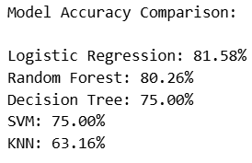
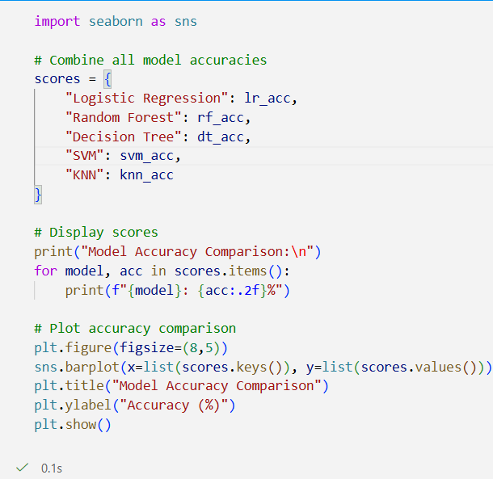
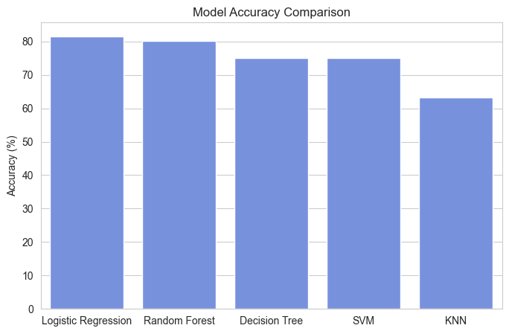
MODELS ACCURACY
In this heart disease prediction project, model accuracy represents how correctly the algorithm predicts whether a patient has heart disease. Higher accuracy means the model makes more correct predictions. Among all the models used, Logistic Regression gave the highest accuracy, making it the most reliable model for this dataset.

Slide 13
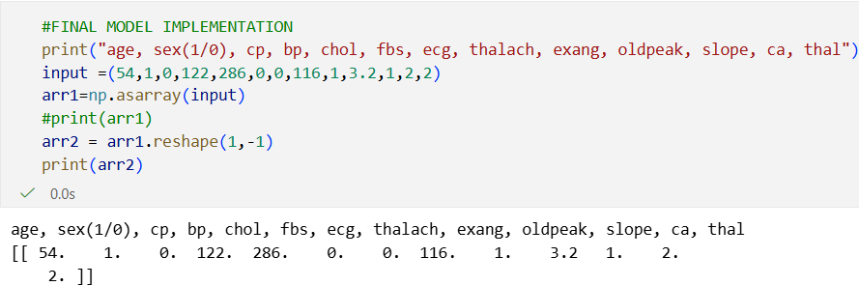
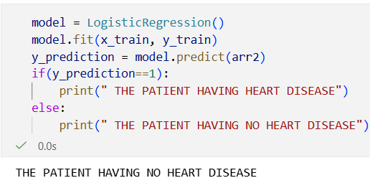
FINAL MODEL IMPLEMENTATION USING LOGISTIC REGRESSION
The selected model is trained using the processed training data (x_train, y_train). Once training is complete, the model is tested on unseen data (x_test) to measure its accuracy and overall performance. After validating the model, it is used to make real-time predictions on new patient input values using the predict() function. The final model returns output as:
1 → Patient has heart disease
0 → Patient does not have heart disease
This final implementation ensures that the model is both accurate and reliable for predicting heart disease based on patient health parameters.

Slide 14
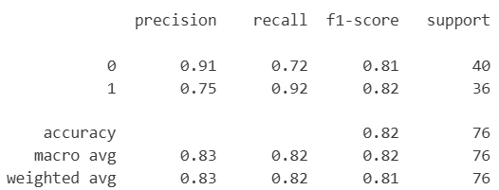

CONCLUSION
In this project, various machine-learning algorithms were applied to predict heart disease using patient health data. After comparing multiple models, Logistic Regression provided the highest accuracy, making it the most effective and reliable model for this dataset. The final model successfully predicts whether a person has heart disease based on key medical features, helping in early detection and decision-making. Overall, the project demonstrates how machine learning can be used to support healthcare with accurate and data-driven predictions.

Slide 15

THANK
YOU.
Contact Me :- subham231003003180@gmail.com

